Slide 1
Revenue Analysis: Financials Exemplar
Actual vs Budget PL Revenue Analysis, YTD, $m
Notes:
USE in Revenue and COGS assignments

Slide 2
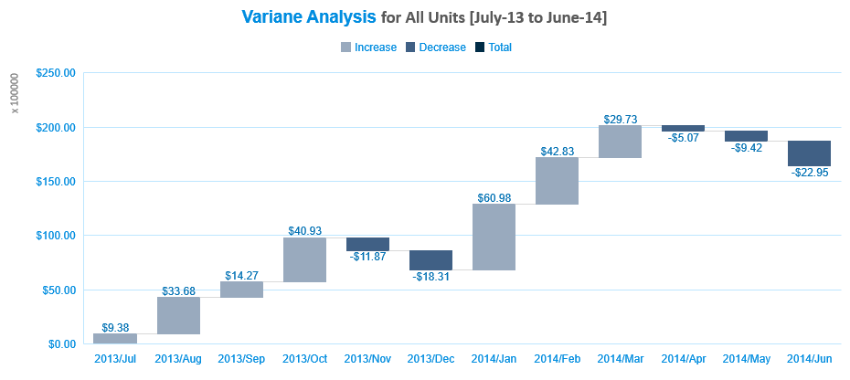
Variance in Revenue for All Units

